Slide 1
Water availability and irrigation water demand from permanent horticulture in the southern MDB
2022 Update
AgVic Webinar | DEECA | Aither
Chris Olszak | Rajiv Venkatraman

Slide 2
What we’ll cover today
Why update the water supply and demand analysis in 2022?
How can water available and permanent horticulture demand be estimated?
What are the key findings from the 2022 update?
What are the key messages from the 2022 update?
Time for Q&A at the end

Slide 3
Why update the water supply and demand analysis in 2022?

Slide 4
Stakeholders have highlighted the need for improvements in the quality, timely and accessibility of water markets information.
New data are available, including 2020-21 water usage data and more recent crop area data.
Questions continue to be raised by stakeholders about how water demand is changing over time.
Changes to availability and trade constraint dynamics are causing water market participants to re-evaluate their water portfolio management strategies.

Slide 5
The 2022 update is the third iteration of the analysis.
The same approach was used in versions 2 and 3.
Version 1
Released on Victorian Water Register in July 2019.
Reliance on ABS data.
Version 2
Released on Victorian Water Register in June 2020 (based on 2018/19 data).
Strong collaboration with state governments and the MDBA.
Input from industry professionals
Access to improved data, particularly water usage data, the latest crop areas data, and potential developments.
Version 3
The 2022 update (based on 2021/22 data). This presentation. Report released 16 March 2023.
Great collaboration with state governments, MDBA and industry professionals again.
Further data improvements, particularly water usage data in the Victorian lower Murray, and updated crop area data.

Slide 6
How can water available and permanent horticulture demand be estimated?
Note: Water demand from permanent horticulture is the volume of water that permanent horticultural plantings could consume based on assumptions about the area of land under permanent horticulture plantings and water application rates for different permanent horticultural crops. This does not suggest that permanent horticulturalists will get the available water.

Slide 7
Estimating water available
Total Entitlement on Issue (2020-21)
Environmental water holdings
Allocations made available to the market
Urban water holdings
End of season allocations
Wet – similar to 2011-12
Average – similar to 2014-15
Dry – similar to 2015-16
Moderately Dry – similar to 2019-20
Extreme Dry – similar to 2007-08

Slide 8
Estimating water demand
This is not locked in.
Estimate 3: Projected water demand estimate (at full maturity)
Estimated water demand from potential permanent horticulture developments
Estimate 2: 2020-21 water demand estimate (at full maturity)
Estimated additional water demand from existing, immature almond, citrus and grape plantings
Estimate 1: 2020-21 water demand estimate
Estimate 1: 2020-21 water demand estimate
2020-21 actual water usage by permanent horticulture
(from state entities)
Estimates 2 and 3 are the focus because they include permanent plantings at full maturity.
2020-21 is the most recent water year for which data were available across Victoria, NSW and SA.
The demand estimate reflects the 2020-21 climatic and market conditions.

Slide 9
Estimating existing water demand at maturity

Slide 10
Estimating existing water demand at maturity

Slide 11
Estimating existing water demand at maturity

Slide 12
Estimating projected water demand
Comparison of additional water usage of planned permanent horticultural crops at maturity included in the Version 2 and Version 3 analyses.

Slide 13
Estimating projected water demand
Comparison of additional water usage of planned permanent horticultural crops at maturity included in the Version 2 and Version 3 analyses.

Slide 14
Estimating projected water demand
Comparison of additional water usage of planned permanent horticultural crops at maturity included in the Version 2 and Version 3 analyses.

Slide 15
What are the key findings from the 2022 update?

Slide 16
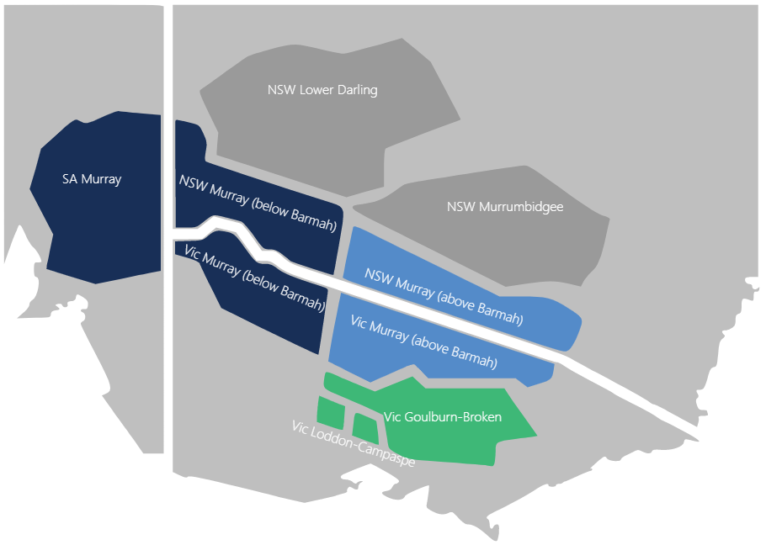
Findings are reported for two regions in the southern MDB
Connected Murray – all coloured zones on the map.
Lower Murray – dark blue zones on the map.

Slide 17
Existing permanent horticulture plantings at full maturity could consume 1,200 GL.
Lower Murray region – existing plantings at full maturity

Slide 18
Existing permanent horticulture plantings at full maturity could consume 1,200 GL.
Lower Murray region – existing plantings at full maturity

Slide 19
The within-region water available may vary by more than 1,000 GL between wet and extreme dry years.
Lower Murray region – existing plantings at full maturity

Slide 20
In moderately dry and extreme dry years, there will likely be no horticultural headroom available.
Lower Murray region – existing plantings at full maturity

Slide 21
Permanent horticulture water demand may increase by between 175 GL and 409 GL if potential developments go ahead.
Lower Murray region – projected water demand at full maturity (developments <1,000 ha)

Slide 22
But, across the connected Murray, water available will likely exceed permanent horticulture demand in most years.
Connected Murray region – existing plantings at full maturity

Slide 23
But, across the connected Murray water supply will likely exceed permanent horticulture demand in most years.
Connected Murray region – projected water demand at full maturity (developments <1,000 ha)
Excludes potential developments 1,000 ha or greater

Slide 24
What are the key findings from the 2022 update?

Slide 25
There is an increasing risk that the demand for water may outstrip the water available under extreme dry conditions.
The findings of the 2022 Update (Version 3) are consistent with those from Version 2.
?
The analysis highlights what could happen, rather than what will happen.
If total permanent horticulture water demand exceeds the volume of water available for irrigation, allocation prices will rise which will induce market responses (including reduced watering, drying off land, and irrigators exit).
Inter-valley trade and carryover are important risk management tools.
Most importantly, all irrigation water users need a Water Strategy to guide their decisions.

Slide 26
What questions do you have?

Slide 27
Thank you
Chris Olszak
Benjamin Williams
Rajiv Venkatraman
Director
Principal | Water Markets
Senior Consultant | Water Markets
+61 425 707 170
+61 415 597 237
+61 452 397 001
chris.olszak@aither.com.au
benjamin.williams@aither.com.au
rajiv.venkatraman@aither.com.au

Slide 28
Disclaimer
© 2023 Aither Pty Ltd. All rights reserved.
Aither makes no warranties or guarantees, expressed or implied, in relation to any information provided in this presentation. Aither’s Water Market Services do not constitute: financial product advice (as that term is defined in section 766B of the Corporations Act (Cth) 2001); a warranty or guarantee in respect to the performance of an investment or as to the solvency of a person, entity or any debt; or legal advice, and should not be relied upon as such.
This document has been prepared on the basis of information available to Aither at the date of publication. Aither relies on data obtained from multiple third-party sources. Consequently, any information presented herein shall be subject to the accuracy and limitations of data obtained from third-party sources.
Aither’s Water Markets Services should not be considered advice or a guarantee with respect to future profit returns on any real property or business. To the full extent permitted by law, Aither excludes all liability for any loss or damage howsoever arising suffered by the Client or any third party, whether as a result of the Client or third party's reliance on the accuracy or otherwise of the information presented herein.
Any individual or entity relying on the information presented in this report and/or Aither’s water market models should be aware that estimates of future outcomes are likely to be affected by inherently unknowable future events and trends. Water markets can be volatile and affected by factors not considered in the analysis such as government policy, regulation, climate, commodity prices and any unforeseen events which may impact water market prices. Individuals and entities should exercise their own skill and judgement in applying modelled outputs to decision-making.

