Slide 1
Water supply and demand in the southern
Murray-Darling Basin – policy update
Gwen DeBoe
Director Water Markets & Grid

Slide 2
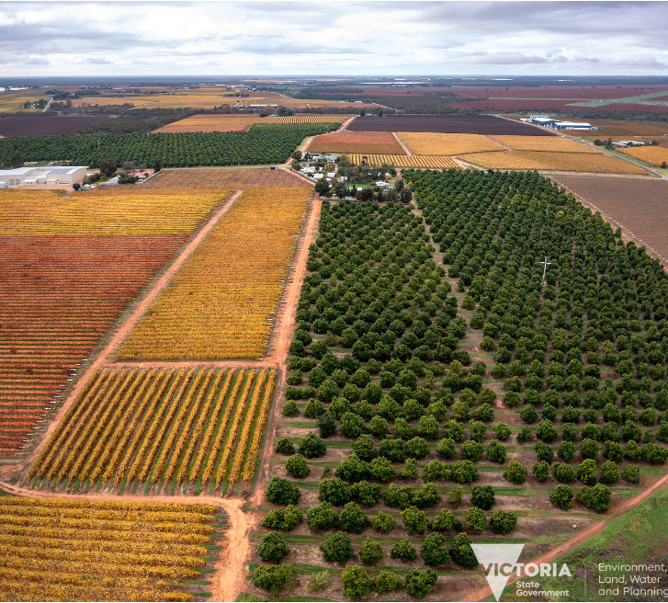
Water market policy
How does the Victorian Government help water users manage their own risks?
All water users are responsible for managing their own water availability risks.
The Victorian government helps put the tools in place to allow water users to manage their water and water availability as flexibly as possible:
Providing market information and reports
Providing flexibility through trade rules, like the Goulburn to Murray trade rule
Improving market confidence, through transparency initiatives, water market reform and investing in market analysis
Also supporting water users to understand and manage delivery shortfall risks (note: different to water availability risk)
Notes:
Intro slide

Slide 3
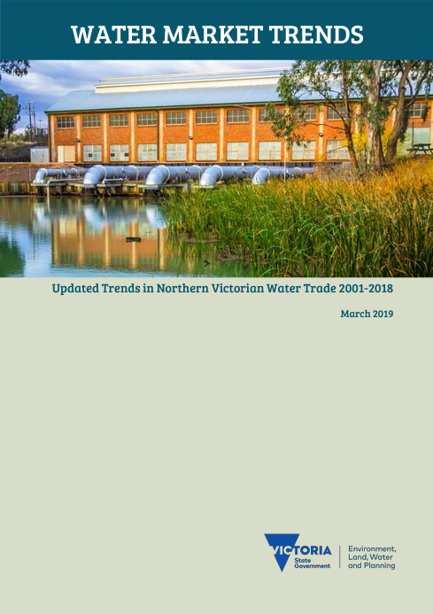
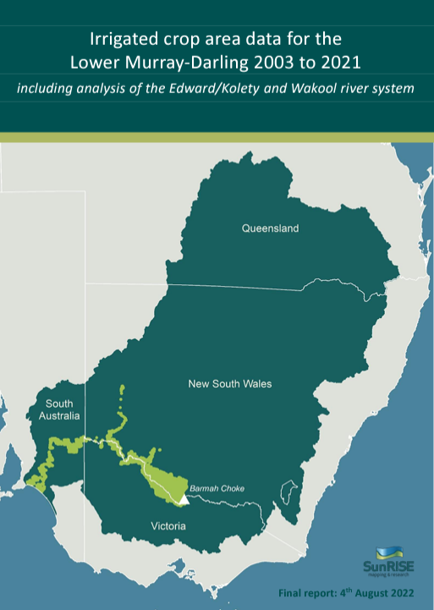
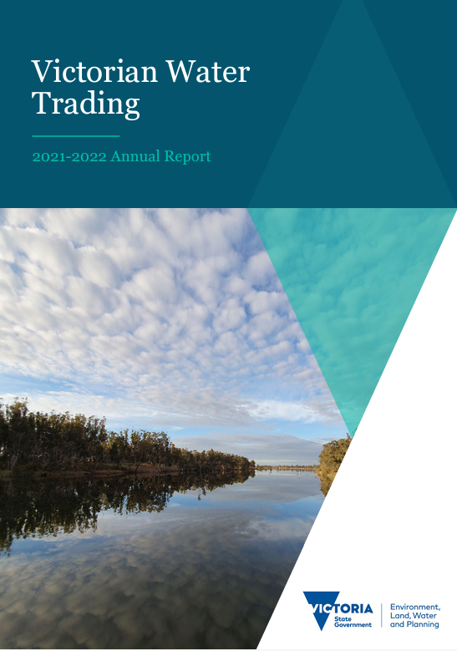
Water market information
Market Information and Reports
The Victorian Government publishes a range of information to support water market participants to make informed decisions about their businesses and manage their water availability risks, including:
Water Market Trends
Water Market Effectiveness
Victorian Water Trading Annual Report
Water Supply and Demand Reports
The Water Supply and Demand in the southern Murray-Darling Basin (2022 update) provides an updated analysis of water supply and demand in the southern Basin and contributes to the Victorian Government’s commitment to improve demand data gathering, information provision and market transparency across Basin states.
Notes:
We publish a range of information on water market trends
For many years now in Victoria we’ve been monitoring and publishing information on irrigated crop area changes, which has now been expanded across the lower Murray-Darling Basin
We’ve published our annual Victorian Water Trading report, with updated analysis on water market prices

Slide 4
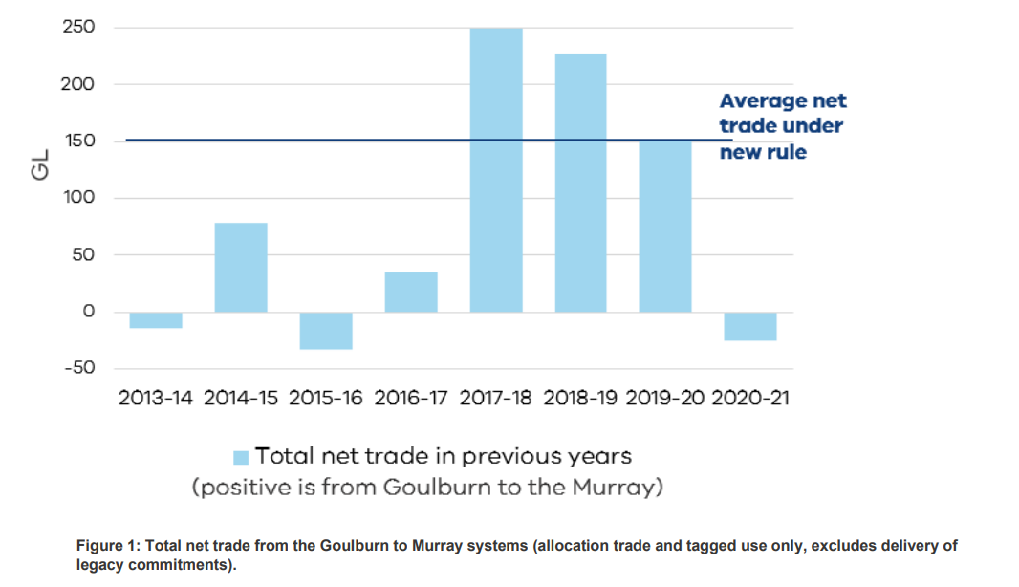
Water market policy
Goulburn to Murray trade rule
A new long-term trade rule came into effect 1 July 2022
The new trade rule limits trade to what can sustainably be delivered within the ecological tolerances of the lower Goulburn River
We saw considerable damage to the river from two consecutive years of high flows; with the new rule in place, we're already starting to see positive signs of recovery
The new rules enable trade as much as possible while avoiding damage occurring, and preventing delivery risks from increasing the River Murray
Notes:
We’re enabling as much trade as we can while protecting tributaries from further damage
The new trade rule is responsive to seasonal conditions and water use patterns – so that we’re matching trade to what we can confidently deliver
Means through the next dry period there will likely be less trade available from the Goulburn, which is necessary to ensure we aren’t adding to existing deliverability pressures in the system

Slide 5
Water market transparency
More transparency to improve market confidence
The Victorian Government monitors water markets to watch how people are using them differently over time, and whether there is any evidence of anti-competitive behaviour or market distortions.
We established an annual water broker audit and we publish a list of water brokers who meet Government standards.
We are expanding current reporting of those who own 2% or more of water in a system or who make more than 20 trades per year to include individual water owner names through legislative changes, while ensuring sensitive information is protected.
Water Ownership below Barmah Choke
Notes:
When the price of water allocation reached all time highs in Victoria in 2019, the water market came under extreme scrutiny and the community demanded greater market transparency. Victoria has undertaken a significant amount of work to meet the community’s expectations around water market transparency and integrity and continues to do so.
With more people more reliant on the market to manage their water availability, improving market confidence and raising the bar on market integrity and transparency is critical, the rules need to mature as the market has, and must be consistently applied across the basin.
The Victorian Government is monitoring water markets to watch how people are using them differently over time, and whether there is any evidence of anti-competitive behaviour or market distortions.
We’ve listened to the community and introduced changes to continue to improving market information (such as publishing the names of companies who own 2% or more of water in a system) and raising broker standards through our Broker Portal & audits.
We did extensive consultation and had feedback from hundreds of irrigators who said they wanted more transparency – but not their individual names and addresses of everyday famers – that’s where we drew the line at 2 per cent.
We are making legislative changes that will allow us to publish the names of individuals (in addition to companies) of those who own two per cent or more of water in a system or who make more than 20 trades per year whilst ensuring we protect sensitive information such as addresses and information about allocation accounts.

Slide 6
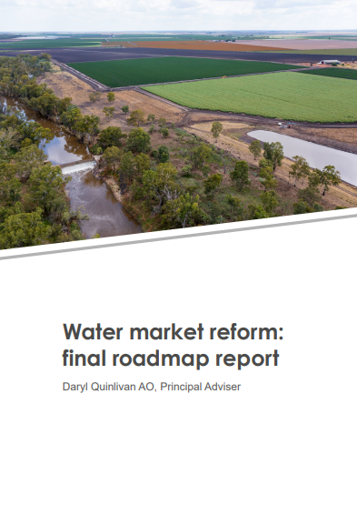
Water market reform
Market reform in the Murray-Darling Basin
We are working with federal and state governments to implement the Water Market Roadmap Report recommendations including:
Greater broker oversight and regulation through the Broker Code
Improving market information and transparency, particularly opening up information out of NSW and South Australian non-government irrigation infrastructure operators
Removing unfair advantages like the grandfathering provisions for a small number of tagged entitlement holders under s.12.23 of the Basin Plan
Agree to refined processes for dealing with water trades across the Barmah choke
Notes:
When the price of water allocation reached all time highs in Victoria in 2019, the water market came under extreme scrutiny and the community demanded greater market transparency. Victoria has undertaken a significant amount of work to meet the community’s expectations around water market transparency and integrity and continues to do so.
With more people more reliant on the market to manage their water availability, improving market confidence and raising the bar on market integrity and transparency is critical, the rules need to mature as the market has, and must be consistently applied across the basin.
Victoria has led the way on improving market information through the Victorian Water Register website (such as publishing the names of companies who own 2% or more of water in a system) and raising broker standards through our Broker Portal & audits.
We support key outcomes of roadmap to implementing ACCC Inquiry recommendations (through the subsequent Water Market Reform Roadmap Report), and Need to work collaboratively between federal and state governments to implement in a consistent, considered, practical and cost effective way
5. Critical first steps include:
Greater broker oversight and regulation through the Broker Code recommended by the ACCC Inquiry
Improving market information and transparency, particularly opening up information out of NSW and South Australian IIOs
Removing unfair advantages like the grandfathering provisions for a small number of tagged entitlement holders under s.12.23 of the Basin Plan
Agree to refined processes for dealing with water trades across the Barmah choke

Slide 7
Thank you
Contact us: Gwendolen.DeBoe@delwp.vic.gov.au
water.markets@delwp.vic.gov.au

