Slide 1
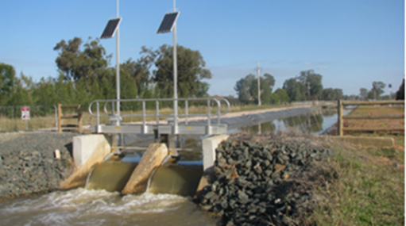
Understanding water supply and demand in the southern Murray-Darling Basin
Irrigation webinar series
Please note:
The webinar will start at 12pm
You are muted
The webinar will be recorded & distributed
Technical issues? Use Zoom “Chat”, contact timothy.robinson@agriculture.vic.gov.au, or phone 0448 587 583
Welcome!
Notes:
Thanks for joining in and welcome to the AgVic Irrigation Webinar Series.
Today’s webinar is titled “Understanding water supply and demand in the southern Murray-Darling Basin.” The focus is on the projected water demand from permanent horticulture and how that compares to water availability under different seasonal scenarios in the southern Basin.
• Roc.
Yorta Yorta.
• Session will be recorded and the link will be emailed to registered participants, probably next week.
• Technical difficulties? Contact Tim Robinson, who is our Webinar Technical Production Manager and is with AgVic also with the Irrigation Team at Kerang. You can contact Tim by using the “Chat” function, by email or by phone – as shown on the screen

Slide 2
Understanding water supply & demand in the sMDB
Webinar outline
Findings of the “Water supply and demand in the sMDB” report.
Chris Olszak. Rajiv Venkatraman.
What DEECA is doing to support irrigators to manage their water-related risks.
Gwen DeBoe.
Notes:
In terms of the program for the day, a presentation will be made on the key findings of the recently released “Water supply and demand in the sMDB” report. This presentation will be made by Chris Olszak, Founding Director of Aither, and Rajiv Venkatraman – lead author of the report. The report was produced by Aither and commissioned by DEECA.
Another short presentation will follow on what DEECA is doing to support irrigators to mange their own water supply risks. This presentation will be made by Gwen DeBoe, Director of Water Markets and Grid, at DEECA.

Slide 3
Other housekeeping
Got a question? Use the Chat function. Select a co-host
Questions answered between speakers & at the end
Your feedback on the webinar is highly valued
Finish at 1.00pm
Notes:
We do encourage you to ask questions
To ask a Q, please use the Zoom Chat function on the bottom of the screen.
• Assuming we are going to time, there will be a break for Qs between the speakers and at the end
• Qs related to the topic will be prioritised.
• Your feedback is highly valued. If you could complete the short webinar survey which will be put up on your screen at the end of the presentations, that will be greatly appreciated.
• Aiming to finish the webinar at 1.00pm.

Slide 4
Thanks to our supporters
Notes:
A special mention to our supporters who include DEECA, the different CMAs along the river, rural water authorities & Aither.
Thanks also to all the FARMING GROUPS and other organisations who assist in promoting these webinars

Slide 5
Water supply & demand in the sMDB
Questions?

Slide 6
Water supply & demand in the sMDB
Wrap-up
Please complete the feedback questions on your screen
Full report and fact sheet available on the Vic Water Register web site www.waterregister.vic.gov.au
Notes:
WRAP-UP
Key points:
Water demand from horticulture is increasing.
In the connected Murray, under extreme dry conditions (and excluding carryover) there will not be enough water available to support all existing permanent horticulture, even if no water is used for other irrigation purposes. Further future increases in permanent horticulture demand may also put pressure on water availability in moderately dry conditions.
In the lower Murray existing and projected horticulture demand may exceed water available within the region in extreme dry, moderately dry and dry conditions (excluding carryover).
Carryover and water trade are increasingly important tools to manage water supply risk.
So, unfortunately it’s bad news - the water availability issue that we’ve experienced over the last few decades is not likely to go away, and it’s important we continue to take steps to manage that water supply risk. In the meantime we’ll just enjoy the current cheap water prices.
Finish
Thanks to Chris, Rajiv, and Gwen and your teams for a great presentations. It’s important work and helps us to better prepare for the future. (Mike Jensz?)
Thanks to Tim for stepping in to keep the webinar afloat, and to Joe Braden for all the good work he’s done for this webinar.
Special thanks to all the webinar participants for supporting us and for your contributions.
A reminder that - It would be big help if you could complete the short list of feedback questions on your screen. - The full report and fact sheet are available on the water register web site.
Thanks again, and have a good afternoon!

